Slide 1
Machine Learning
Azure focused.

Slide 2
Objective
Presentation
Basics of ML
Why and where
Intelligent conversation
Demo
You can do some experiments.
Run some data to find patterns.
Score your models.
Deploy this in a useable form.
Use the model in DARE I SAY IT in Production!!!

Slide 3
What is ML?
ML
Find Patterns in existing data.
Create and use model that recognizes patterns in new data.
ML Process
Iterative
Challenging
Quantifying Success .

Slide 4
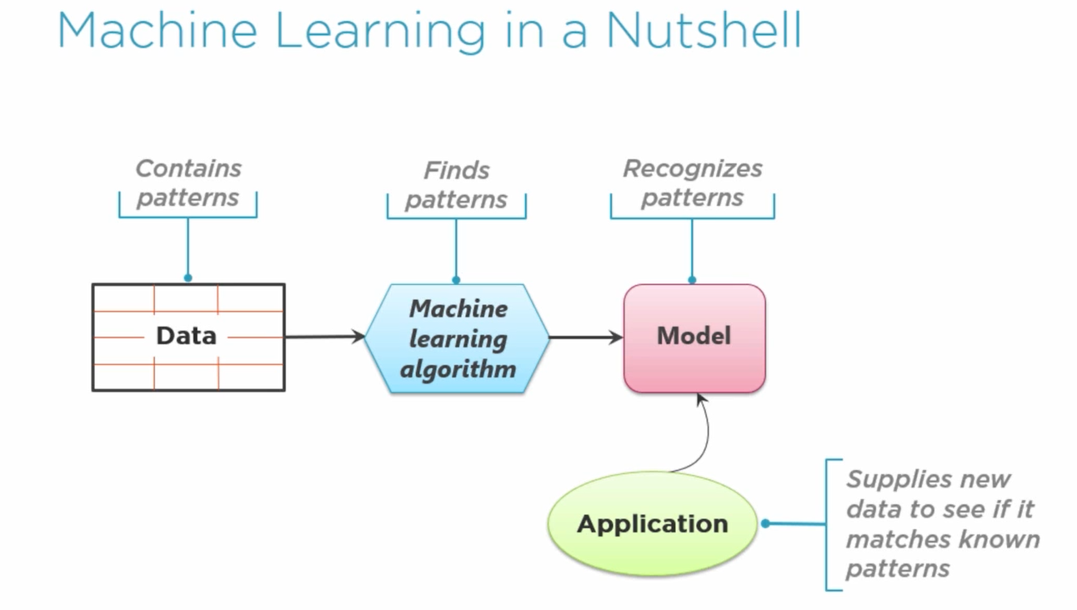

Slide 5
Why now
Space and time
Lots of data – Big data
Lots of Computing Power - Cloud
Effective Machine Learning algorithm– Data scientist have spend decades in developing this.
Audience
Business Leaders want effective solutions.
Software developers for effective business process flows in CRM implementation.
Data scientist – Statics , ML Software and Domain experts

Slide 6
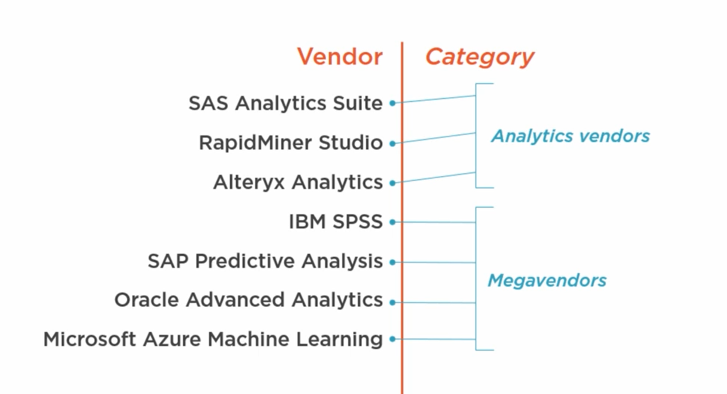
Vendors

Slide 7
ML Lifecycle
Ask the right question
Choose the right data to answer the question.
Good amount of data
Good shape
Iterate until the model makes good prediction- Quantifying Success as 100% is not possible. So set acceptable standards.
Deploy the model.
Rebuild and Deploy periodically – Continuous Learning.

Slide 8
Scenario
Customer Churn in Cable
CRM Data
Call detail aggregate applications Hadoop or Spark etc
Use above and ML to predict churn and offer better deal
CC fraudulent transaction prediction.
Devices that streaming data to real time processor that has a ML Prediction interaction.

Slide 9
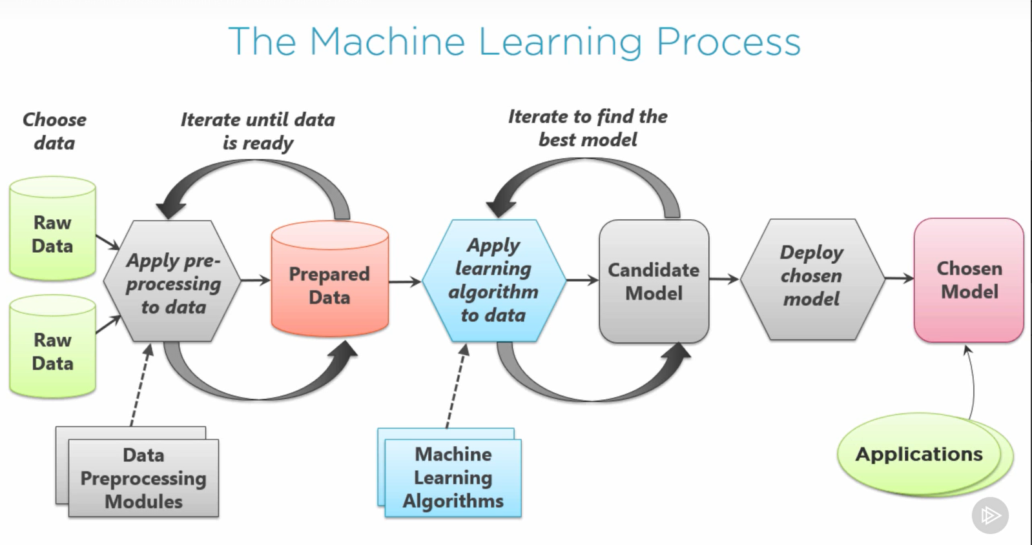

Slide 10
Terminology
Training Data – Prepared data.
Supervised Learning – The Value you want predict is in the training data[labeled].
Unsupervised Learning - The value you want to predict is not in the training data. Data is unlabeled
Classification of Data (common ones)
Regression
Classification
Clustering
Styles of Machine Learning Algorithm
Decision tree
Neural tree
Bayesian
K-means [algorithm]
Training Model. Features that predicts target value. 75% of all data is sent.
Testing a Model. Develop a Candidate Model
Score a model – Change features, change algorithm, more data – iteration model.

Slide 11
Demo

